Slide 1


INSTITUTE : UIE
DEPARTMENT : CSE
Bachelor of Engineering (Computer Science & Engineering)
WEB AND MOBILE SECURITY (Professional Elective-I)
(20CST/IT-333)
TOPIC OF PRESENTATION:
Client-side scripting, Server-side scripting.
DISCOVER . LEARN . EMPOWER

Slide 2
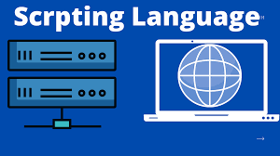
Lecture Objectives
In this lecture, we will discuss:
Introduction to Web development. Difference between Client-side scripting, Server-side scripting.

Slide 3
Client-side scripting
Web browsers execute client-side scripting. It is used when browsers have all code. Source code is used to transfer from webserver to user’s computer over the internet and run directly on browsers.
Client is Browser
Activities like popup on reloading, mouse over activities
used for validations and functionality for user events.
Form validity checked and shows success/error message
Example: Javascprit
Reduce server load

Slide 4
Server-side scripting
Web servers are used to execute server-side scripting. They are basically used to create dynamic pages. It can also access the file system residing at the webserver. A server-side environment that runs on a scripting language is a web server.
It is used to retrieve and generate content for dynamic pages. It is used to require to download plugins.

Slide 5
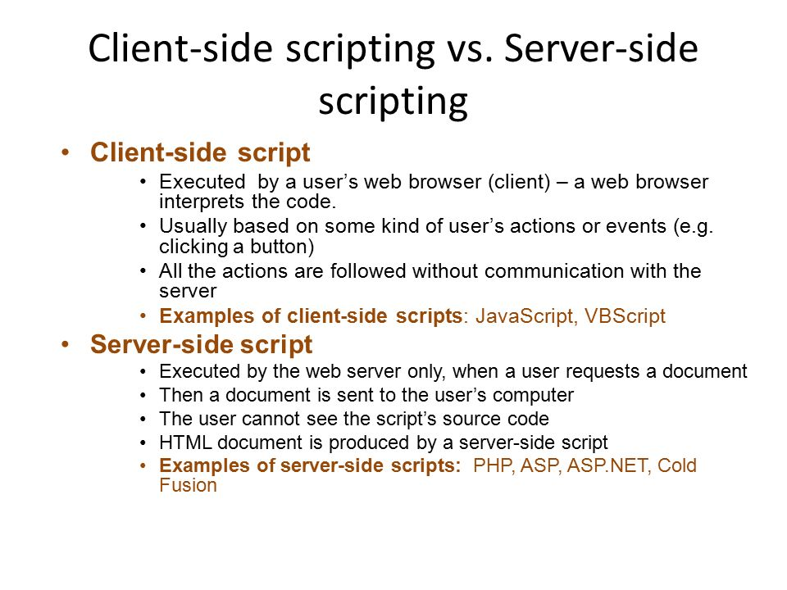

Slide 6
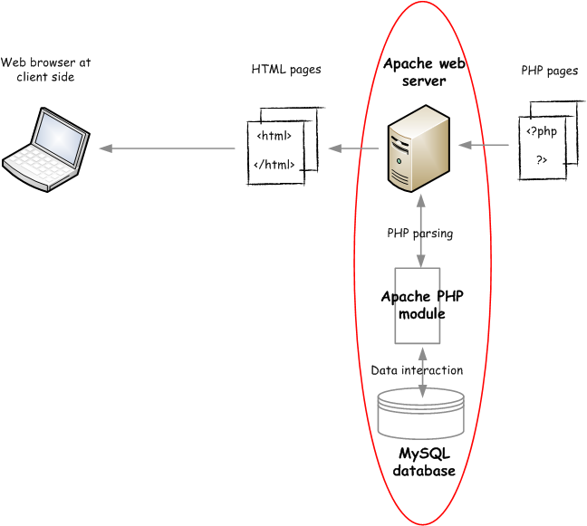

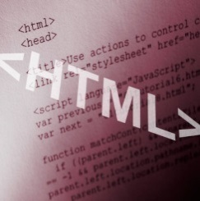


HTTP
(HTML-content,
CSS code,
JavaScript code)
HTML pages
The web application model:
The client-server model
Client-side web programs run on clients.
Server-side web programs run on servers.
HTTP between client- and server-side web programs
Where are client-side web programs stored?
Where are server-side web programs stored?
For what do we need to use a server-side web program?
How many tiers do you see in the above diagram?
3 tier model
HTTP-URL
(*.html, *.php)
PHP pages
PHP module

Slide 7
Overview
Client-side web programs are written in HTML, CSS, and JavaScript.
HTML and CSS display elements in a web document(/page/program) on a window. -> static programs
All HTML elements are modeled by DOM.
JavaScript controls and changes the elements through DOM so that the users can see the change on the window. -> interactive programs
JavaScript is also used to exchange information with a server-side web program.
Server-side web programs are written in PHP, JavaScript(, HTML, CSS, JavaScript), ….
They are usually used to access databases.
They generate web content(, i.e., client web programs,) that will be sent back to the client. -> dynamic programs
They are also used to exchange information with a client-side web program.
JavaScript and PHP are complete programming languages.
A whole new programming paradigm.

Slide 8
Overview – cont.
Client-side programs |  |  |  |  | Server-side scripts |  | SQL, NoSQL
HTML CSS Bootstrap | DOM <---> |  | JavaScript … |  | PHP Java … |  | MySQL MongoDB …
User interface |  | Processing Logic |  |  | Processing Logic |  | Processing
Web client: Chrome FireFox … |  |  |  |  | Web server: Apache Node.js … |  | DB server: MySQL …

Slide 9
Overview – cont.
Client |  | Server |  | Communication | Other
HTML5 CSS3 (user interface) | JavaScript DOM (processing) | PHP | MySQL | Polling, SSE iframe AJAX JSON, XML | Security Cookies, sessions
Static web pages <------------------>
Interactive web applications <----------(COMP 2680)---------->
Bootstrap jQuery Dynamic web applications <------------------------------------------------------------------->
Rich dynamic web applications <--------------------------------------------------(COMP 3540)---------------------------------------------------->
Bootstrap | jQuery AngularJS T3PO … | Node.js … | MongoDB | WebSocket WebRTC … | Web services Frameworks Mining HTML5 APIs…
Web-based information systems <---------------------------------------------------(COMP 4620)--------------------------------------------------->

Slide 10
Client-side scripting | Server-side scripting
Source code is visible to the user. | Source code is not visible to the user because its output of server-sideside is an HTML page.
Its main function is to provide the requested output to the end user. | Its primary function is to manipulate and provide access to the respective database as per the request.
It usually depends on the browser and its version. | In this any server-side technology can be used and it does not depend on the client.
It runs on the user’s computer. | It runs on the webserver.

Slide 11
Client-side scripting | Server-side scripting
There are many advantages linked with this like faster. response times, a more interactive application. | The primary advantage is its ability to highly customize, response requirements, access rights based on user.
It does not provide security for data. | It provides more security for data.
It is a technique used in web development in which scripts run on the client’s browser. | It is a technique that uses scripts on the webserver to produce a response that is customized for each client’s request.
HTML, CSS, and javascript are used. | PHP, Python, Java, Ruby are used.

Slide 12
Client-side scripting | Server-side scripting
No need of interaction with the server. | It is all about interacting with the servers.
It reduces load on processing unit of the server. | It surge the processing load on the server.

Slide 13
References:
Books:
Web Design With HTML, CSS, JavaScript and jQuery Set, 1st Edition, by Jon Duckett.
Hacking Exposed Web Applications, 3rd edition, Joel Scambray, Vincent Liu, Caleb Sima, Released October 2010, Publisher(s): McGraw-Hill
Video Lectures :
1. https://www.youtube.com/watch?v=V1aQyoRy91k
Reference Links:
https://cs.tru.ca/~mlee/comp3540/Fall2021/2.%20web_environment/00%20overview%20-%20common.ppt
https://www.geeksforgeeks.org/difference-between-server-side-scripting-and-client-side-scripting/
https://www.slideserve.com/ziven/server-side-scripting

Slide 14

THANK YOU

